Slide 1


Dr. Dowlah/Fall2016

Slide 2
This Chapter explains why Aggregate Demand is crucial in Keynesian Economics and How Keynesian Model works.
Just as Aggregate Demand—Aggregate Expenditures have the same components:
Consumption (C )
Private Business Investment (I)
Government Purchases (G)
Net Exports (X-M)
AD = C + I + G + X -M
Dr. Dowlah/Fall2016

Slide 3
Households can do three things with their income
They can consume ( C ),
They can save(S), and
They can pay taxes (T).
Therefore, Y = C + S + T
Consumption (C )--Part of consumer income that is spent on consumption goods
Saving (S)—part of consumer income that is withdrawn from current consumption
Tax (T)— part of income withdrawn by the government
Dr. Dowlah/Fall2016

Slide 4
Disposable Income (Yd)= Income – taxes. That is, Yd= Y - T
Disposable Income (Yd)= Consumption and Saving = C + S
Consumption= Disposable Income minus Saving = Yd - S
Saving= Disposable Income- consumption = Yd – C
Dr. Dowlah/Fall2016

Slide 5

(Yd) (C ) (S)
$0 $30 -$30
$100 $100 $0
$200 $170 $30
$300 $240 $40
In this table when Yd is zero, Consumption is $30. This is called Autonomous Consumption.
The level of consumption that is independent of income is called Autonomous Consumption.
When Yd is zero, your consumption is $30. That means, you have negative saving or Dissaving of $30. This part of spending is financed by borrowing or past income or past savings.
Dr. Dowlah/Fall2016

Slide 6
The consumption function (CF) shows the relationship between consumption and disposable income in the economy.
The Saving function (SF) shows the relationship between saving and disposable income in an economy
Dr. Dowlah/Fall2016

Slide 7
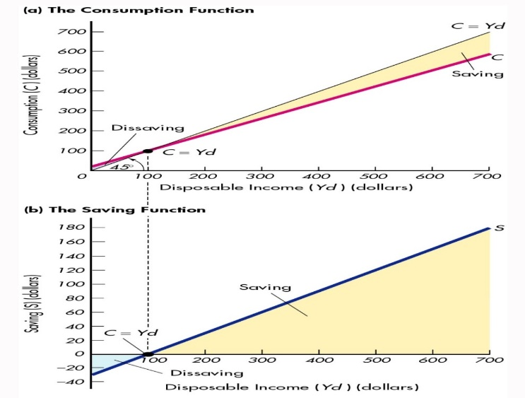
These graphs are based on the Table. These graphs show C=Yd when saving is zero.
When consumption exceeds Yd, saving is negative, and when Yd exceeds consumption, saving is positive.
The mid-line, that divides the top graph in the middle, is called 45 degree line or Equi-divider line.
The 45 degree line shows all the points that are the same distance from both axes—on all the points on 45 degree line consumption equal disposable income.
Dr. Dowlah/Fall2016

Slide 8

C represents consumption function. The 45 degree line or Equi-divider line shows all the points where consumption equals disposable income.
C crosses 45 degree line where C is equal to Yd. C is equal to Yd means saving is zero at this point. Any point below C=Yd, saving is negative. Any point beyond C=Yd, saving is positive.
Saving occurs at any level of Disposable Income at which consumption function lies below the 45 degree line.
Saving is the vertical distance between the 45 degree line and the Consumption Function. Whenever Consumption Function is above the 45 degree line --the economy is experiencing dissaving
Dr. Dowlah/Fall2016

Slide 9
A consumer’s consumption behavior depends on his/her Marginal Propensity to Consume (MPC). MPC is the ratio of the change in consumption to the change in disposable income. MPC= Change in Consumption divided by change in Yd.
A consumer’s saving behavior depends on his/her Marginal Propensity to Saving (MPS). MPS = Change in Saving divided by change in Yd. MPS is the ratio of the change in saving to the change in disposable income.
Dr. Dowlah/Fall2016

Slide 10
Yd | C | S | MPC | MPS
$0 100 200 300 400 500 600 700 | $30 100 170 240 310 380 450 520 | -$30 0 30 60 90 120 150 180 | -- .70 .70 .70 .70 .70 .70 .70 | -- .30 .30 .30 .30 .30 .30 .30
Sum total of MPC and MPS is 1.0
MPC + MPC = 1.0. MPS= 1.0 – MPC. MPC= 1.0 – MPS.
That means, MPC must fall if MPS goes up, and vice versa.
Dr. Dowlah/Fall2016

Slide 11
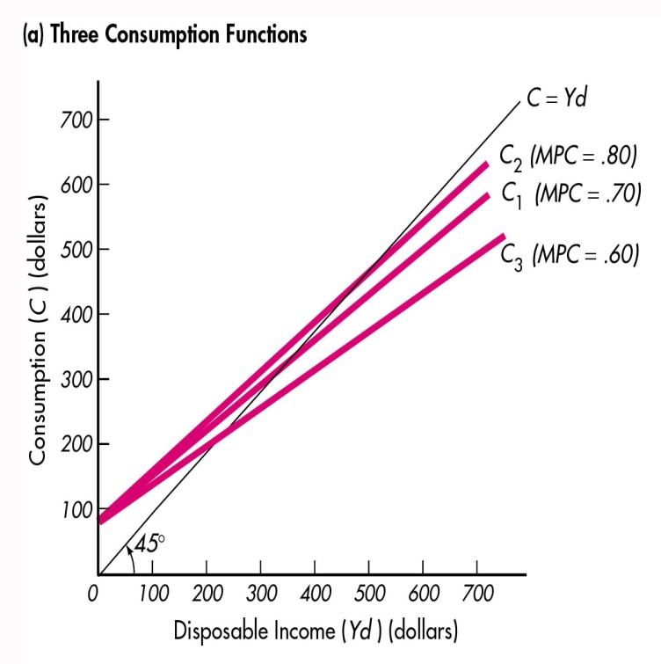
The MPC is the Slope of the Consumption Function
The higher the MPC, the steeper the slope. The lower the MPC, the flatter the slope of Consumption Function.
Dr. Dowlah/Fall2016

Slide 12
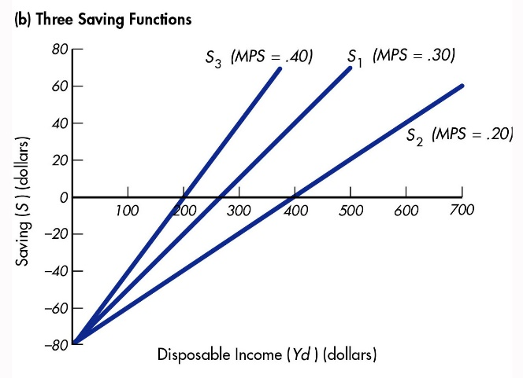
The MPS is the slope of the Saving Function
The greater the MPS, the steeper the saving function
Dr. Dowlah/Fall2016

Slide 13
Average Propensity to Consume (APC)=The proportion of disposable income spent for consumption. (APC = C/Yd)
Average Propensity to Save (APS)= the proportion of disposable income that is saved. (APS = S/Yd)
Dr. Dowlah/Fall2016

Slide 14

Yd | C | S | APC | APS
$0 100 200 300 400 500 600 700 | $30 100 170 240 310 380 450 520 | -$30 0 30 60 90 120 150 180 | -- 1.0 .85 .80 .78 .76 .75 .74 | -- 0 .15 .20 .22 .24 .25 .26
As the Table shows, APC+APS = 1.0. APC = 1.0 - APS; APS = 1.0 - APC
Dr. Dowlah/Fall2016

Slide 15

Any change in Autonomous Consumption,Wealth,
Expectations, or Demographics
will cause a shift in consumption function and saving function
Dr. Dowlah/Fall2016

Slide 16
Autonomous consumption is the amount of consumption that exists when real GDP is zero. It is the intercept of the consumption function.
Autonomous saving is the amount of saving that exists when real GDP is zero. It is the intercept of the saving function.
Autonomous increase in consumption moves the intercept of the consumption function. Autonomous increase in saving moves the intercept of the saving function
Dr. Dowlah/Fall2016

Slide 17

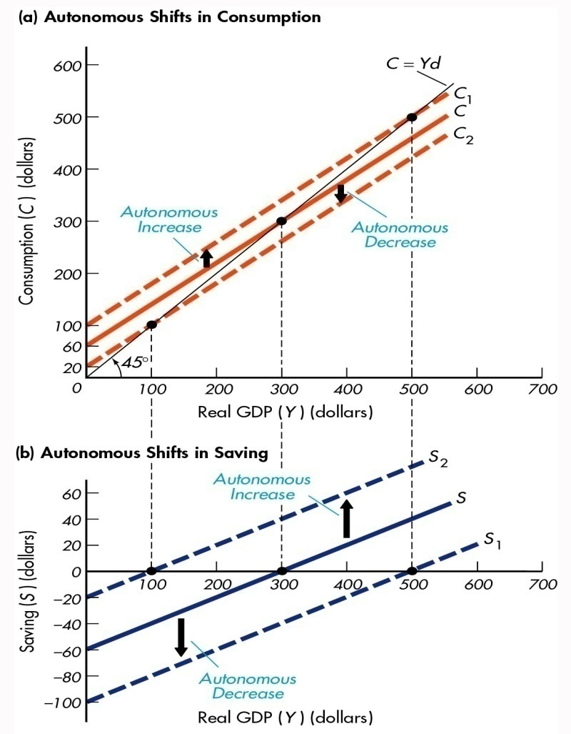
Dr. Dowlah/Fall2016

Slide 18
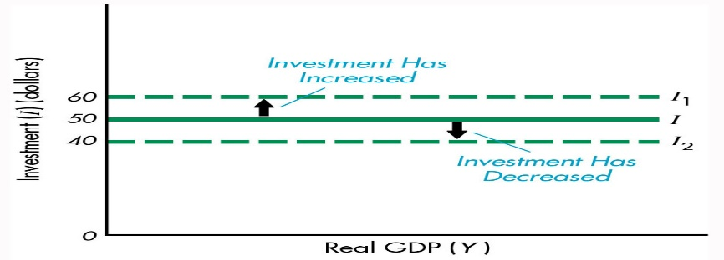
If investment increases to $60 billions, there will be a parallel shift of Investment Function upward. Similarly, if investment decreases to $40 billion, there will be parallel shift of Investment Function downward.
Dr. Dowlah/Fall2016

Slide 19

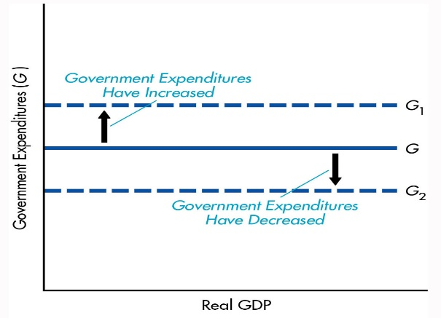
In our model, government Spending is considered autonomous.
If government spending goes up, there will be a parallel shift of G upward.
If Government Spending goes down, there will be a parallel shift of G downward.
Dr. Dowlah/Fall2016

Slide 20

In our Model, exports are considered autonomous, but imports are not. Imports depend on income.
That, in turn, depends on Marginal Propensity to Imports (MP1).
MPI= (change in imports/change in Yd).
Dr. Dowlah/Fall2016

Slide 21
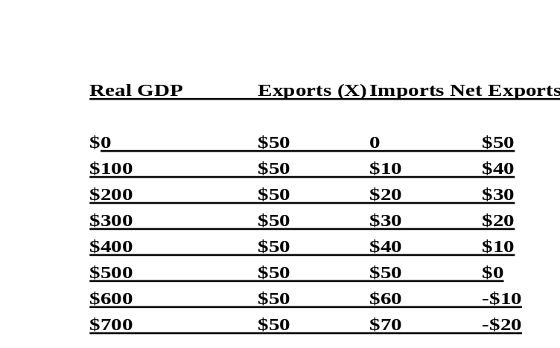
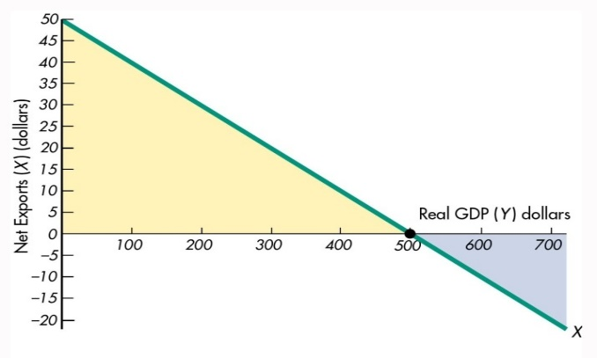
Dr. Dowlah/Fall2016

Slide 22
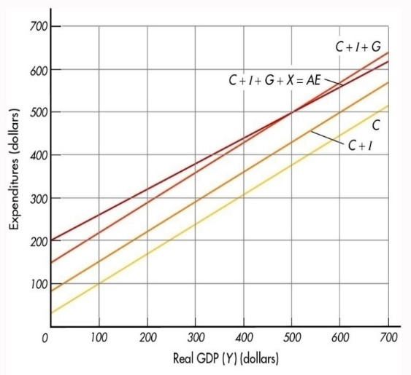
Y C I G X-M AE
$0 $30 $50 $70 $50 $200
100 50 70 40 260
170 50 70 30 320
240 50 70 20 380
310 50 70 10 440
380 50 70 0 500
600 450 50 70 -10 560
Aggregate Expenditure= C + I + G + X –M.
Sum of C, I, G, X-M horizontally at each level of Y. This Y is real GDP.
Dr. Dowlah/Fall2016

Slide 23

The Aggregate Expenditure (AE)
The real GDP equals AE at $500 billion. Above that point—AE is below real GDP. Below that point—AE is above real GDP
That means, when output is below equilibrium, AE exceeds output, so inventories are depleted. The difference between the 45 degree line and AE line is the amount of inventory depletion at the level of output.
Dr. Dowlah/Fall2016

Slide 24

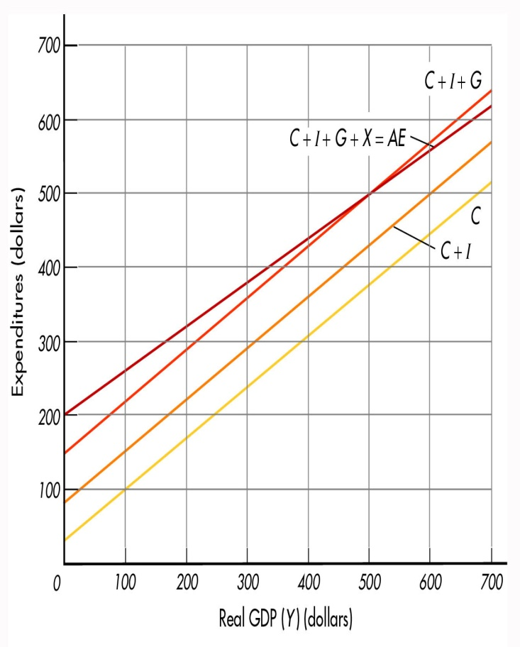
Addition of autonomous investment and autonomous government spending cause parallel shift in the consumption function
Dr. Dowlah/Fall2016

